Slide 1


Field Project
Google Form Analysis Study
Physics Wallah Survey

Slide 2
What is PW?
PW (Physics Wallah) is an Indian educational technology company that focuses on providing affordable and quality education, mainly in the fields of science and mathematics. It was founded by Alakh Pandey in 2016, initially as a YouTube channel, and has grown into a full-fledged ed-tech company offering online courses, live classes, and study materials for students preparing for various competitive exams, such as JEE and NEET.
Key Highlights:
  Founder: Alakh Pandey
  Established: 2016
  Services: Online courses, study materials, live classes, test series, and doubt-clearing sessions.
  Focus Areas: JEE, NEET, and other competitive exam preparations.

Slide 3
Introduction
Welcome to the presentation on the Physics Wallah survey. This survey aims to gather insights from students about their experiences with the platform. In this presentation, we will analyze the findings to better understand student perspectives and draw meaningful conclusions.
This survey gathers valuable insights from students on their experiences with the Physics Wallah platform. By analyzing the findings, we aim to better understand student preferences, identify areas of improvement, and highlight strengths in teaching, content, and engagement. These insights will guide us in making informed recommendations to enhance the learning experience.
In this presentation, we will focus on key findings regarding student satisfaction, preferred learning methods, content effectiveness, and engagement. The goal is to draw meaningful conclusions that will help improve the platform, ensuring it continues to meet student needs and supports their academic success.

Slide 4
Working/Methodology of PW
Content Creation and Delivery:
  Video Lectures: PW creates high-quality video lectures that are tailored for various competitive exams like JEE, NEET, and GATE. These lectures are delivered in an engaging, easy-to-understand manner to simplify complex concepts.
  Live Classes: PW conducts live interactive classes, allowing students to learn in real-time and engage with teachers through Q&A sessions.
  Recorded Sessions: Students who miss live sessions can access recorded versions, making learning flexible and convenient.
Study Materials and Resources:
  PW provides comprehensive study materials that include detailed notes, question banks, practice tests, and revision guides.
  Test Series and Quizzes: Regular mock tests and quizzes are provided to help students assess their understanding and improve problem-solving skills.
Affordable Pricing:
  One of PW’s key features is its affordability. It offers high-quality education at a low cost, making it accessible to a larger number of students, especially those in rural or economically weaker sections.

Slide 5
Objectives
Assess Student Satisfaction: Evaluate overall student satisfaction with the Physics Wallah platform.
Identify Learning Preferences: Understand students’ preferred learning methods and resources.
Analyze Content Effectiveness: Gather feedback on the quality and effectiveness of the course materials.
Explore Engagement Levels: Examine how engaged students feel with the content and delivery.

Slide 6
Analysis
Data Collection:
The survey was distributed to 100 students, targeting [High School Students, College Students].
2. Satisfaction Ratings:
Overall satisfaction score: 90%
Breakdown of ratings:
  Very Satisfied: 43.4%
  Satisfied: 41.4%
  Dissatisfied: 12.1%
  Very Dissatisfied: 3%

Slide 7
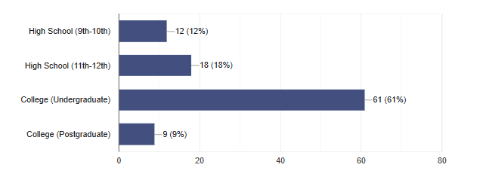
What is your current level of study?

Slide 8
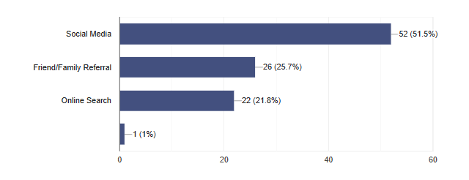
2. How did you hear about Physics Wallah classes?

Slide 9
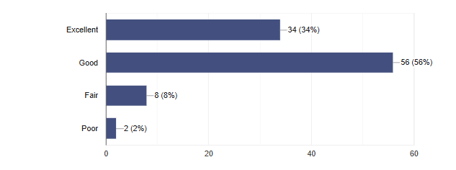
3. How would you rate the quality of teaching in our classes?

Slide 10
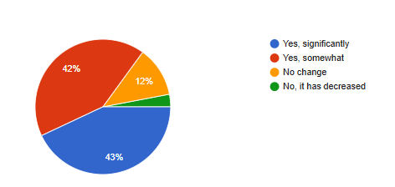
4. Have you noticed improvement in your understanding since joining our classes?

Slide 11
Conclusion
The survey results highlight a high overall level of student satisfaction with the Physics Wallah platform, with a substantial proportion of students providing positive feedback about their learning experience. The course materials are generally considered effective; however, there is a clear demand for more interactive content and additional practice questions to reinforce understanding. Although many students report being highly engaged, there remains a segment that feels less connected, suggesting that enhancements to student interaction and involvement are needed. Key insights from open-ended responses reveal a strong appreciation for the clarity of explanations and the diverse range of resources offered, while also emphasizing areas for improvement. Moving forward, it is essential to focus on developing more interactive elements and providing supplementary practice materials to better address student needs and further enhance the learning experience.

Slide 12
References
Physics Wallah: https://www.pw.live/
YouTube: https://www.youtube.com/

Slide 13
Thank You

